Slide 1
Teaching Demonstration: K-means Clustering
Ari Smith

Slide 2
Preliminary assumptions
In context of a course on Artificial Intelligence methods, portion of the semester devoted to machine learning
Students have seen supervised learning methods but not unsupervised learning
Students understand key ML terms such as target, feature, observation, hyperparameter
Familiarity with Jupyter notebook, pandas, and sklearn basics
Lecture adapted from Machine Learning in Action by Prof. Justin Boutilier, itself partially adapted from The Analytics Edge by Dimitris Bertsimas
K-means Clustering

Slide 3
Overview
Unsupervised learning
The basics of clustering
K-means clustering
Optimal approach
Heuristic approach: Lloyd’s algorithm
How to use in practice Lab Files: bit.ly/4iivVqD
Example: Clustering news articles
K-means Clustering

Slide 4
Setup and Motivations

Slide 5
Supervised vs. Unsupervised learning
Supervised learning: predict/explain a target variable given feature variables
Unsupervised learning: learn patterns in observations with no target, only feature variables
K-means Clustering

Slide 6
Business Application: segmentation/taste-communities
Understanding how a customer base can be segmented into different groups can help in understanding how to best serve all clients
In online platforms, users can often informally develop their own communities based on the content they interact with
Ex. BookTok, PetTok, PerfumeTok
Being able to recognize communities, and identify users as members of certain communities can be useful for recommending content
K-means Clustering

Slide 7
Unsupervised application: taste-communities
In 2018, Netflix grouped users into ~1300 “taste-communities” to recommend content
Prior to 2016, recommendations were given uniformly by country of user
Cluster 290:
Movies like: Black Mirror,
Lost, and Groundhog Day
K-means Clustering

Slide 8
Clustering Basics

Slide 9
The goal of clustering
Clustering is an unsupervised learning algorithm
Partition data into clusters such that the observations within a cluster are similar to each other
K-means Clustering

Slide 10
How do we define “similar”?
We use distance metrics to measure similarity of two observations
Define an observation with F features:$x_{i}={\left(x_{i1},x_{i2}, …, x_{iF}\right)}^{T}$
A function $d\left(x_{1},x_{2}\right)$ is a distance metric if it satisfies the following criteria
Non-negativity: $d\left(x_{1},x_{2}\right)≥0$ and $d\left(x_{1},x_{2}\right)=0$ iff $x_{1}=x_{2}$
Symmetry: $d\left(x_{1},x_{2}\right)=d\left(x_{2},x_{1}\right)$
Triangle inequality: $d\left(x_{1},x_{2}\right)+d\left(x_{2},x_{3}\right)≥d(x_{1},x_{3})$
K-means Clustering

Slide 11
Distance metrics
Euclidean:
$$d\left(x_{1},x_{2}\right)={\left\|x_{1}−x_{2}\right\|}_{2}={\left(\sum_{f=1}^{F}{{\left|x_{1f}−x_{2f}\right|}^{2}}\right)}^{\frac{1}{2}}$$
Manhattan:
$$d\left(x_{1},x_{2}\right)={\left\|x_{1}−x_{2}\right\|}_{1}=\sum_{f=1}^{F}{\left|x_{1f}−x_{2f}\right|}$$
Chebyshev:
$$d\left(x_{1},x_{2}\right)={\left\|x_{1}−x_{2}\right\|}_{∞}=\max_{f=1,…,F}\left|x_{1f}−x_{2f}\right|$$
K-means Clustering

Slide 12
Defining a cluster
Index set: includes the IDs of all observations in a cluster
$$S_{k}=\{1,3,7,21,44\}$$
Centroid: the “center” or “representative point” of each cluster
$$s_{k}=\frac{1}{|S_{k}|}\sum_{i∈S_{k}}{x_{i}}$$
K-means Clustering

Slide 13
Cluster distances
Intra-cluster distance: distance between two points in the same cluster
Inter-cluster distance: distance between points in different clusters
K-means Clustering

Slide 14
K-means Clustering

Slide 15
K-means clustering
Partition observations into k clusters in a way that minimizes the total squared Euclidean distance between each observation and its cluster’s centroid
i.e., minimizes variance of observations within clusters
Hyperparameters
k – number of clusters
K-means Clustering

Slide 16
K-means: optimization problem
Decision variables:
$a_{ij}$: 1 if observation i assigned to cluster j, 0 otherwise
$s_{j}$: centroid of cluster j
Data:
$x_{i}$: observation i
minimize $\sum_{i}{\sum_{j}{a_{ij}} ||x_{i}−s_{j}{||}_{2}^{2}}$
subject to $\sum_{j}{a_{ij}}=1$, $∀i,$
$\sum_{i}{a_{ij}}≥1$, $∀j,$
$a_{ij}∈\{0, 1\}$, $∀i,j,$
$s_{j}∈ℝ^{F}$, $∀j.$
K-means Clustering

Slide 17
Heuristic Approach
Optimization problem is NP-Hard, time to solve grows exponentially as dataset size increases (not practical for big data)
Instead, a heuristic approach is most often used: Lloyd’s Algorithm
Understanding how algorithm works has practical implications for using k-means clustering
K-means Clustering

Slide 18
Lloyd’s Algorithm
Randomly initialize k centroids
Assign each observation to its closest centroid using the distance metric
Recompute the cluster centroids as mean of assigned observations
If centroids do not change, stop. Otherwise, return to step 2.
Finds local optimum, but not always global optimum each time
K-means Clustering

Slide 19
Lloyd’s Algorithm Pseudocode
$s_{j} :=$ random_sample($x_{1}… x_{n}$) for $j∈1…k$
While True:
$S_{j}≔\{\}$ for $j∈1…k$
for $i∈1…n$:
$c ≔{argmin}_{j∈1…k} d(x_{i},s_{j})$
$S_{c}≔S_{c}∪x_{i}$
$s_{j}^{∗} :=\frac{1}{|S_{j}|}\sum_{i∈S_{j}}{x_{i}}$ for $j∈1…k$
if $s_{j}==s_{j}^{∗}$ for all $j∈1…k$:
return $S_{j},$ $s_{j}$ for $j∈1…k$
$s_{j} :=s_{j}^{∗}$
K-means Clustering

Slide 20
Lloyd’s Algorithm Example
K-means Clustering

Slide 21
Lloyd’s Algorithm
In practice, terminates much faster than optimal formulation
However, clusters are local optima, not global optima
Clusters found depend on randomly chosen starting centroids
Repeat algorithm with multiple random starts and keep best performing clusters, to maximize chance of finding global optima
K-means Clustering

Slide 22
Using k-means in practice
Hyperparameters
k
Number of repetitions with random start
Features should be normalized/on a similar scale so some features don’t have outsized impact of distance metric compared to others
Python package sklearn.cluster.Kmeans easy to use (only supports Euclidean)
K-means Clustering

Slide 23
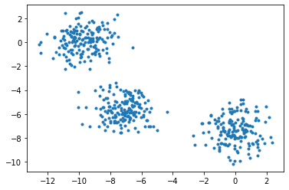
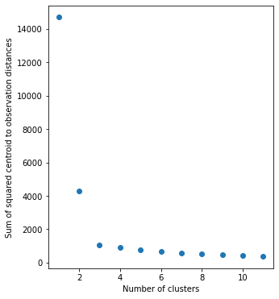
How do we select k?
Elbow plot method
Plot total squared intra-cluster distances for many values of k
Find “elbow” where decreases in total distance become marginal
K-means Clustering

Slide 24
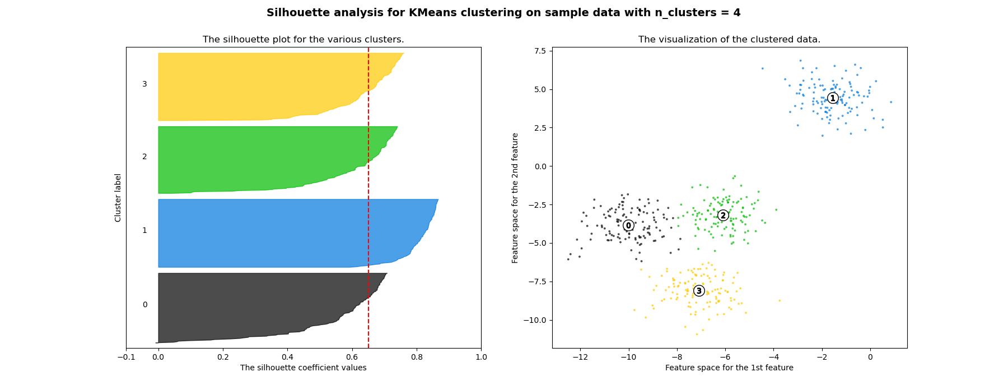
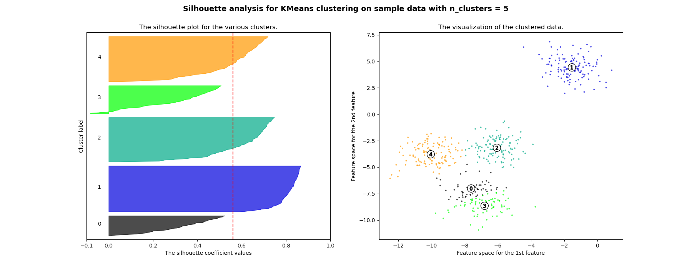
Silhouette Score Method
Scores observations by how close they are to other members of cluster against closeness to next nearest cluster
Clusters with low mean scores either:
can be broken into more clusters (k too low)
are not meaningfully distinct from another cluster (k too high)
K-means Clustering

Slide 25
Practical Example: DailyKos

Slide 26
Overview
Internet blog, forum, and news site devoted to the Democratic Party and liberal politics
Obtained 3430 articles with 1545 features from Fall 2004
Each feature is a variable corresponding to the number of times a word appears
What were the hot topics on DailyKos at the time?
Files can be found at bit.ly/4iivVqD
K-means Clustering

Slide 27
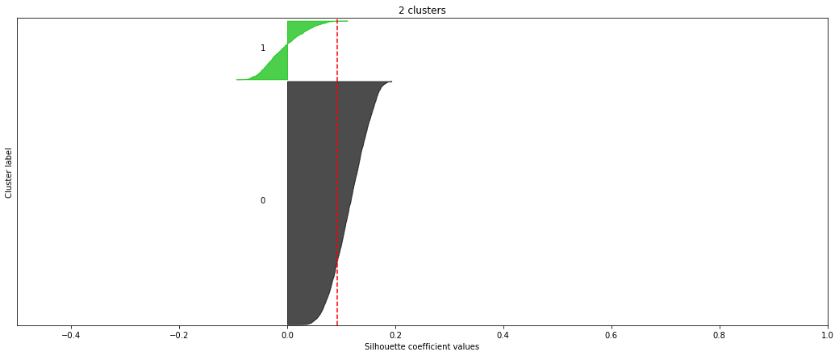
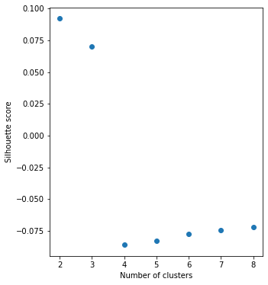
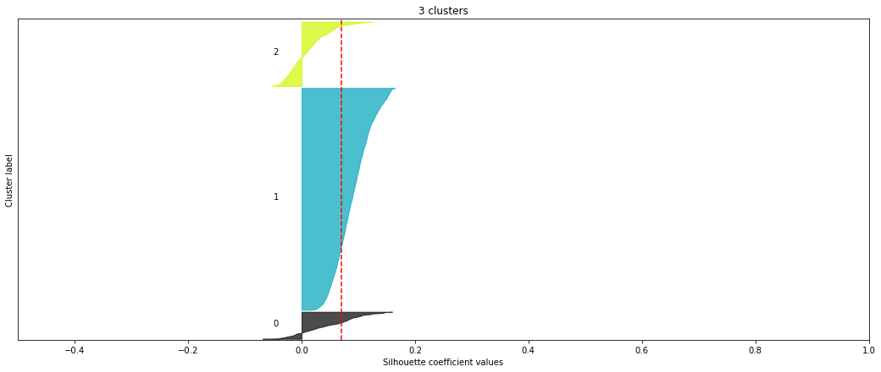
Elbow Plot and Silhouette Plots
K-means Clustering

Slide 28
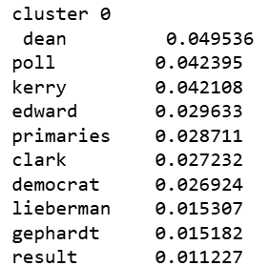
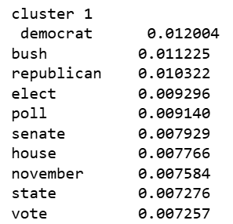
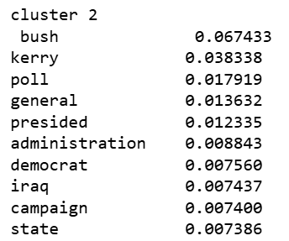
Centroid Analysis
Too many features to look at entire centroids
Examine 10 largest features of each centroid
Most popular words in articles within cluster
K-means Clustering

Slide 29
Next Lesson
Hierarchical/Agglomerative Clustering
Linkage Criteria
Interpreting Dendrograms
Application to DailyKos Dataset, comparison with k-means clusters
K-means Clustering

Slide 31
Extra Slides

Slide 32
Breakdown of Optimal Formulation
Decision variables:
$a_{ij}$: 1 if observation i assigned to cluster j, 0 otherwise
$s_{j}$: centroid of cluster j
Data:
$x_{i}$: observation i
minimize $\sum_{i}{\sum_{j}{a_{ij}}||x_{i}−s_{j}{||}_{2}^{2}}$
subject to $\sum_{j}{a_{ij}}=1$, $∀i$
$\sum_{i}{a_{ij}}≥1$, $∀j$
$a_{ij}∈\{0, 1\}$, $∀i,j$
$s_{j}∈ℝ^{F}$, $∀j$
Total distance between observations and assigned centroids is minimized
All observations are assigned to exactly one cluster
Each cluster is non-empty
Variables are properly defined
K-means Clustering

Slide 33
Informal proof that Lloyd’s alg finds local optimum
Sum of squared distances (aka loss function) is a function of index sets and centroid coordinates
For any fixed centroid coordinates, assigning observations to nearest centroids minimizes total distances
For any fixed cluster index sets, setting centroids as mean feature values minimize total distances (for Euclidean metric)
Thus, loss function cannot increase at any iteration
If index sets and centroids do not change in an iteration, partial derivative of loss function w.r.t. all input variables = 0, so a local extrema is found
K-means Clustering

Slide 34
Informal proof that Lloyd’s alg terminates
Index sets must change at every iteration, and cannot repeat (or else loss function would increase by returning to previous iteration)
There is a finite number of index set combinations ($k^{n}$)
Therefore, Lloyd’s algorithm must terminate in a finite number of iterations $i$ (in practice usually significantly smaller than $k^{n}$, and does not usually increase rapidly with n)
Each iteration is $O(knF)$, so full algorithm is $O(knFi)$
K-means Clustering

